Slide 1

Course Name: Hardware Security
Faculty Name: Prof Debdeep Mukhopadhyay
Department : Computer Science and Engineering
Topic
Lecture 06 : Hardware Design for Finite Field Inverse

Slide 2

Concepts Covered:
Multiplicative Inverse in GF(2^{m})
Itoh-Tsujii Inversion Algorithm
Generalization of Itoh-Tsujii
Hardware Design of Itoh-Tsujii
Performance of the Hardware Circuit

Slide 3
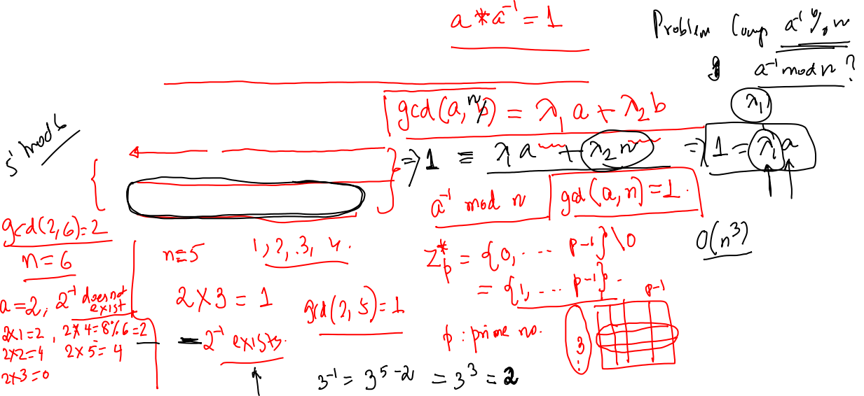
Multiplicative Inverse
Given an element ‘a’, find a⁻¹ in the field such that a.a⁻¹ = 1.
Techniques
Extended Euclid’s Algorithm
Fermat’s Little Theorem
Fermat’s Little Theorem is more efficient on hardware than the Euclidean technique.
Fermat’s Little Theorem
a⁻¹ = a^{n-2} mod n
For example 3*3⁽⁵⁻²⁾ mod 5 = 3*2 mod 5 = 1

Slide 4
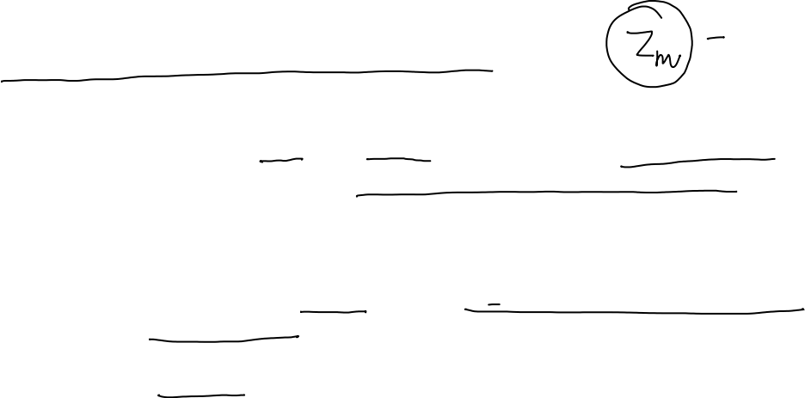
Euler's Totient function
Suppose a≥1 and m≥2 are integers. If gcd(a,m)=1, then we say that a and m are relatively prime.
The number of integers in Z_{m} (m>1), that are relatively prime to m and does not exceed m is denoted by Φ(m), called Euler’s Totient function or phi function.
Φ(1)=1

Slide 5
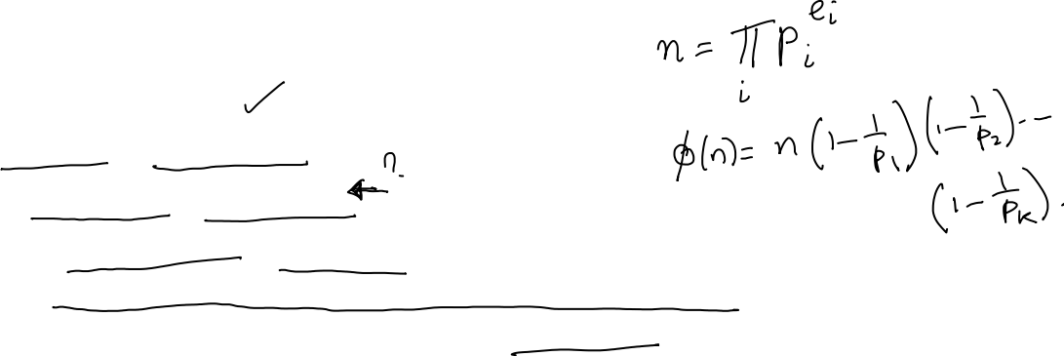
Example
m=26 => Φ(26)=12
If p is prime, Φ(p)=p-1
If n=1,2,…,24 the values of Φ(n) are:
1,1,2,2,4,2,6,4,6,4,10,4,12,6,8,8,16,6,18,8,12,10,22,8
Thus we see that the function is very irregular.

Slide 6
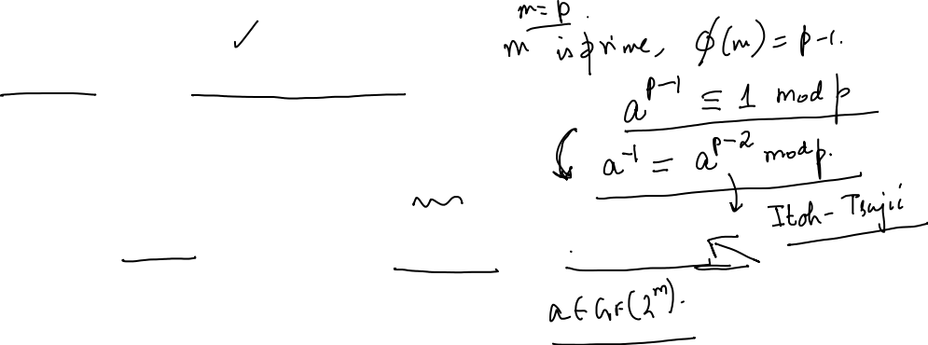
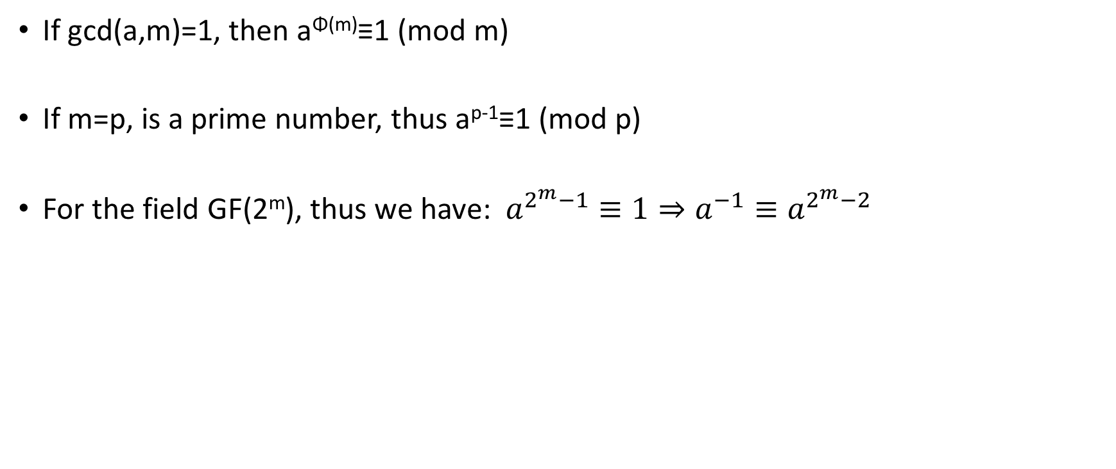
Fermat’s Little Theorem and Finite Field Inverse
If gcd(a,m)=1, then a^{Φ(m)}≡1 (mod m)
If m=p, is a prime number, thus a^{p-1}≡1 (mod p)
For the field GF(2^{m}), thus we have: $a^{2^{m}−1}≡1⇒a^{−1}≡a^{2^{m}−2}$

Slide 7

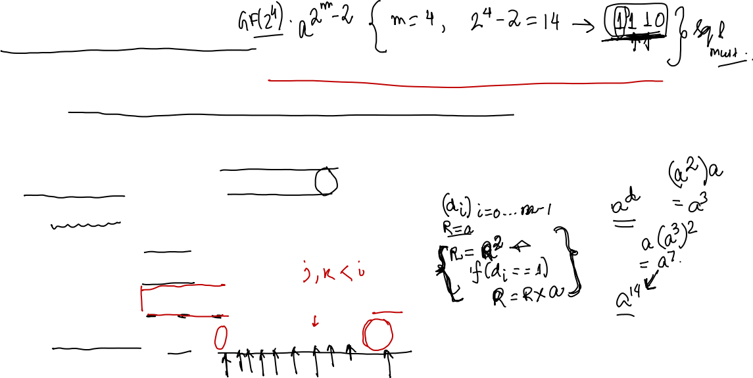
Addition Chain
Naïve method would require (m-1) squarings and (m-2) field multiplications.
Since, multiplication is costly we don’t apply this method.
Itoh-Tsujii algorithm reduces the number of field operation by using an addition chain for (m-1).
Addition Chain for a positive integer n is a sequence of natural numbers U=(u₀,u₁,…,u_{l}), st. the following are satisfied:
Example: addition chain for 162, U=(1,2,4,5,10,20,40,80,81,162)

Slide 8
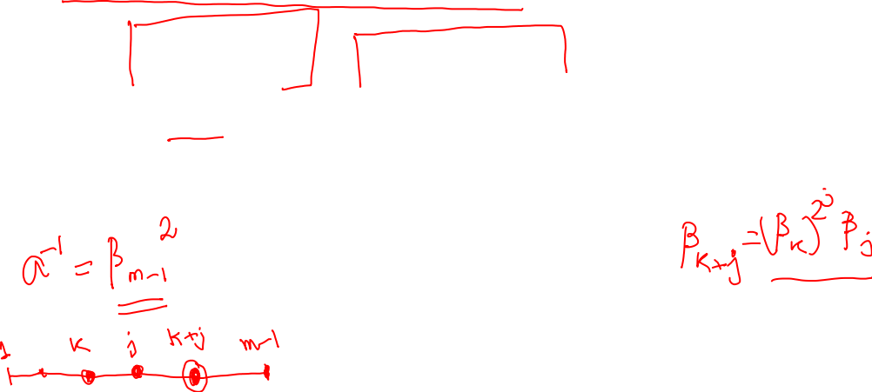
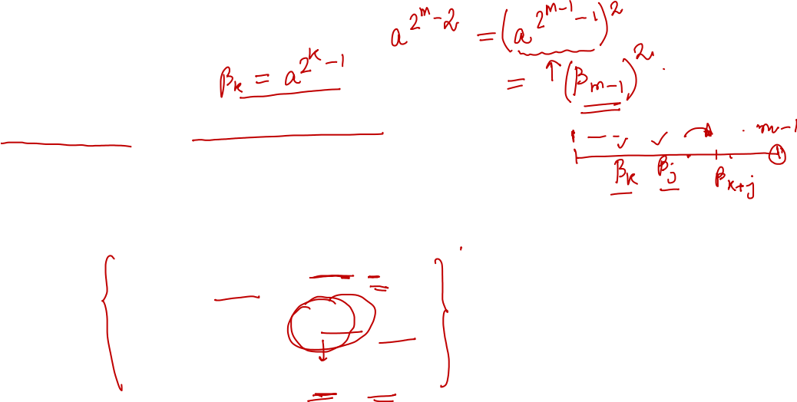
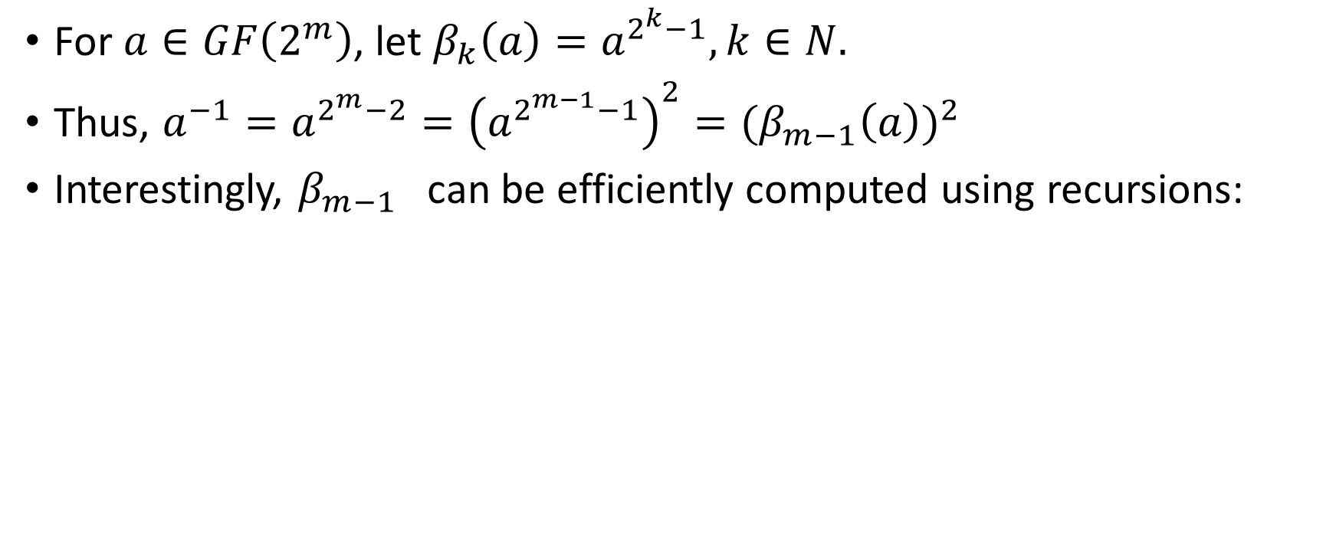
Itoh-Tsujii Algorithm
For $a∈GF\left(2^{m}\right)$, let $β_{k}\left(a\right)=a^{2^{k}−1}, k∈N.$
Thus, $a^{−1}=a^{2^{m}−2}={\left(a^{2^{m−1}−1}\right)}^{2}={(β}_{m−1}{\left(a\right))}^{2}$
Interestingly, $β_{m−1}$ can be efficiently computed using recursions:

Slide 9
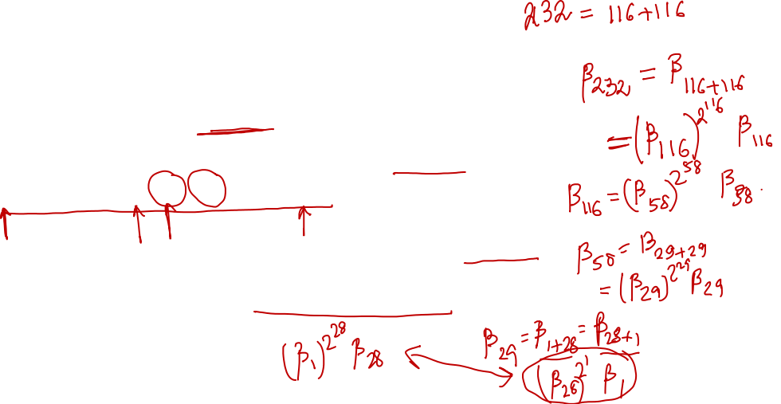
Example for m=233
We need to find a⁻¹ = a^{2m-2} for m=233
We first define an addition chain for m – 1
(1,2,3,6,7,14,28,29, 58,116, 232)
Then, define β_{k}= a^{2k-1} then a⁻¹ = (a²²³²⁻¹)² = (β₂₃₂)²
Also define the recursion β_{k+j}= (β_{k})^{2j}β_{j}
F.R.Henríquezez et. al., A Fast Implementation of Multiplicative Inversion Over GF(2^{m}), ITCC ’05:

Slide 10
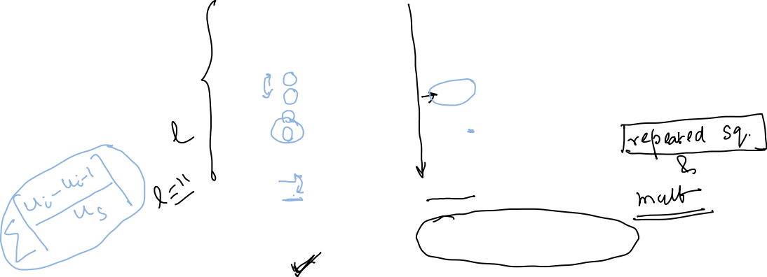

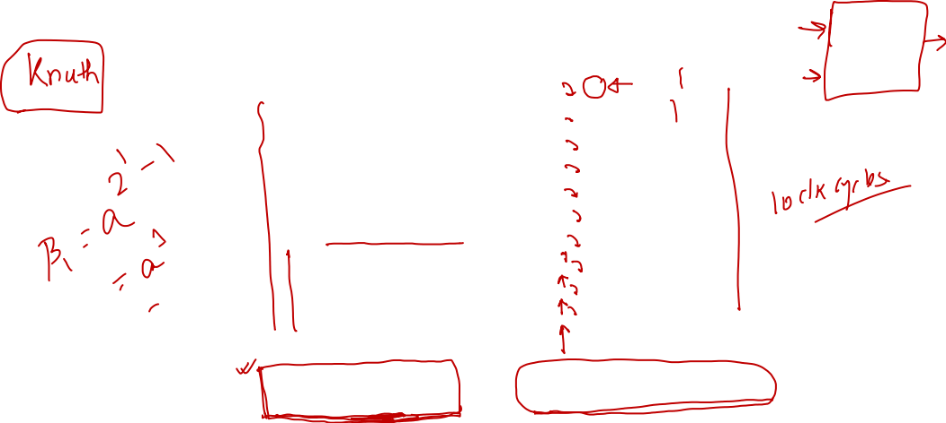
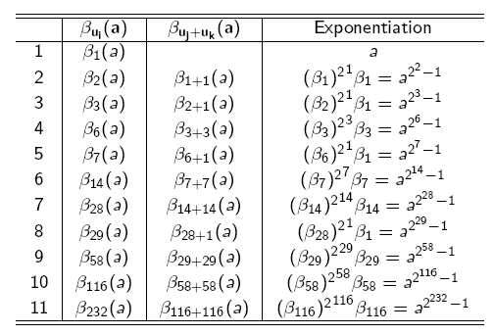
Computing the Inverse of ‘a’
In all we need 232 squarings and 10 multiplications.

Slide 11
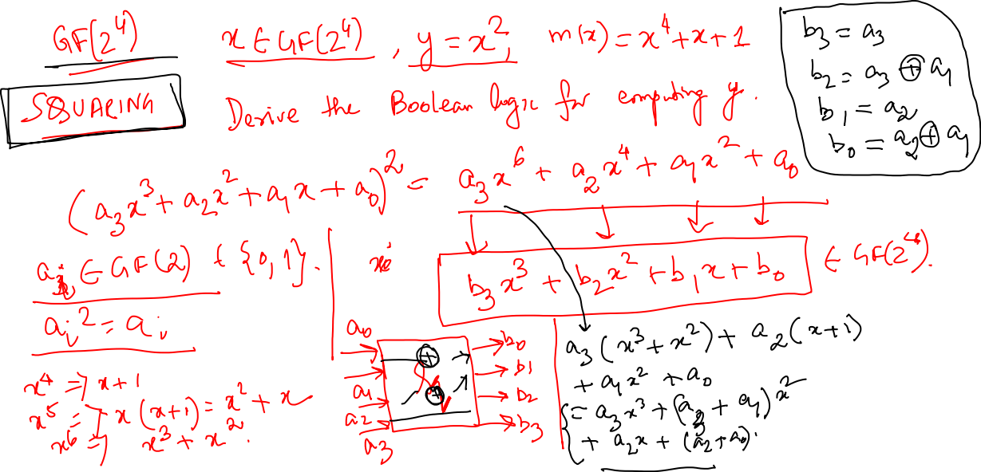

Slide 12
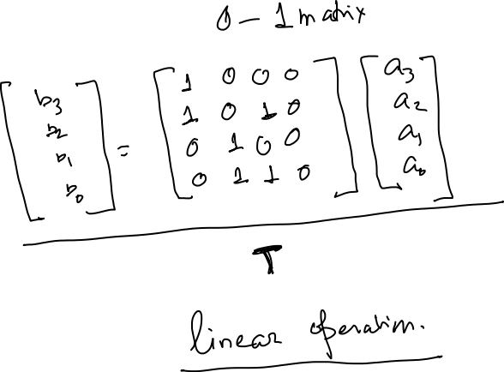

Slide 14
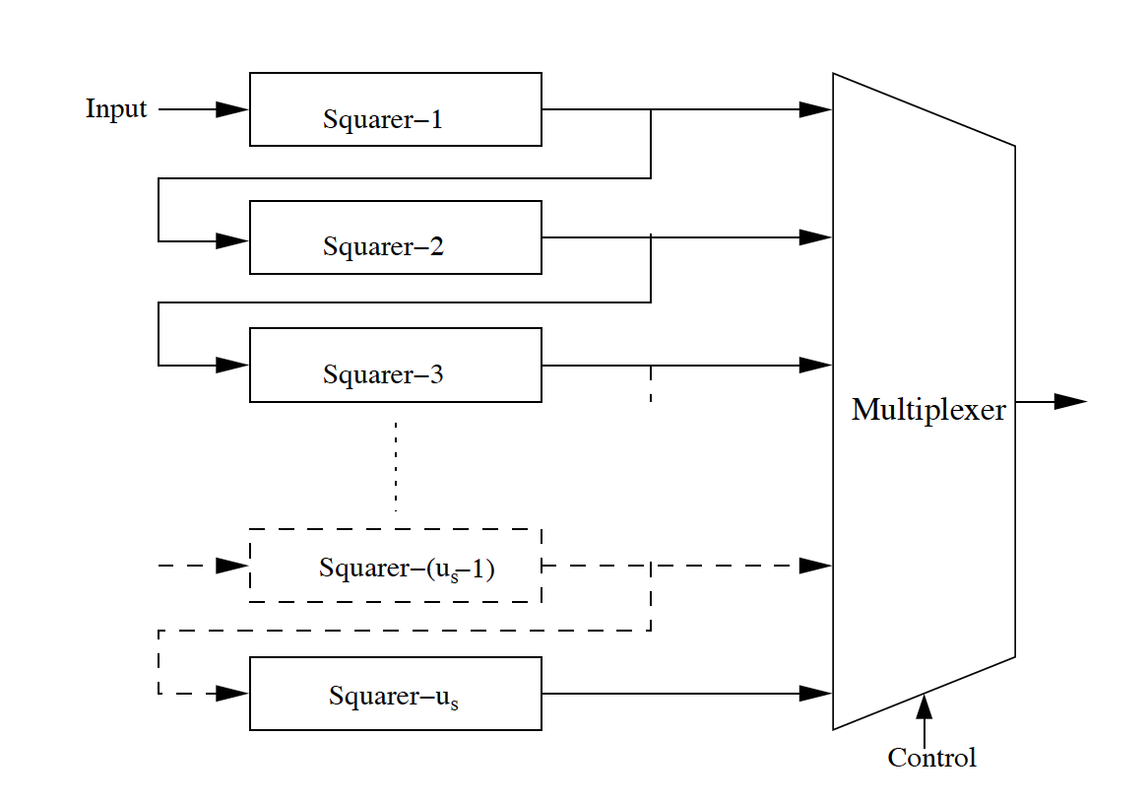
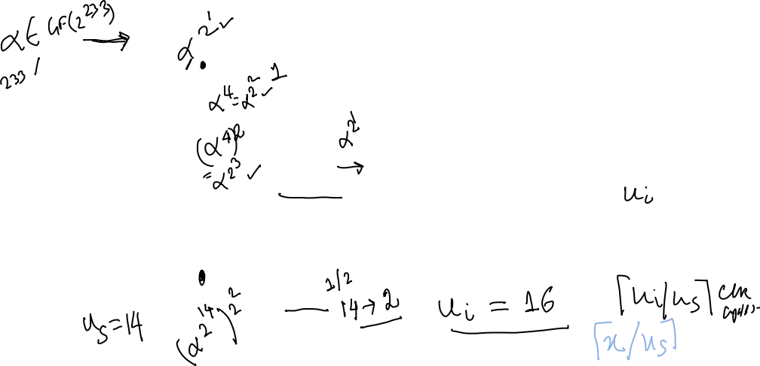
Circuit to Raise Input to Power of 2^{k}
Number of squarings at a stage can be as high as u_{i}/2
A naïve way would require u_{i}/2 squarings at each step.
Circuit cascades us squarers, where u_{s} is an element in the addition chain.
If number of squarings required is less than u_{s}, a multiplexer is used to tap out interim outputs.
In this case, the output is obtained in one clock cycle.
If the number of squarings is more than u_{s}, the output of the squaring block is fed back to get squares which are multiples of us. This would require clock cycles.

Slide 15
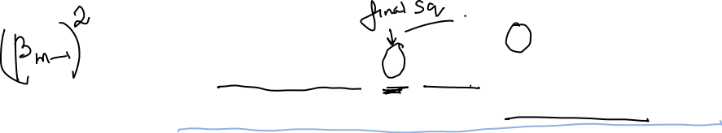
Estimating the number of clock cycles
The (l-1) term is due to (l-1) multiplications, assuming one clock cycle for each.
The summation terms are for the squarings at each steps: note, that the number of squarings required are proportional to (u_{i}-u_{i-1}).
The extra clock cycle is for the final squaring operation.

Slide 16
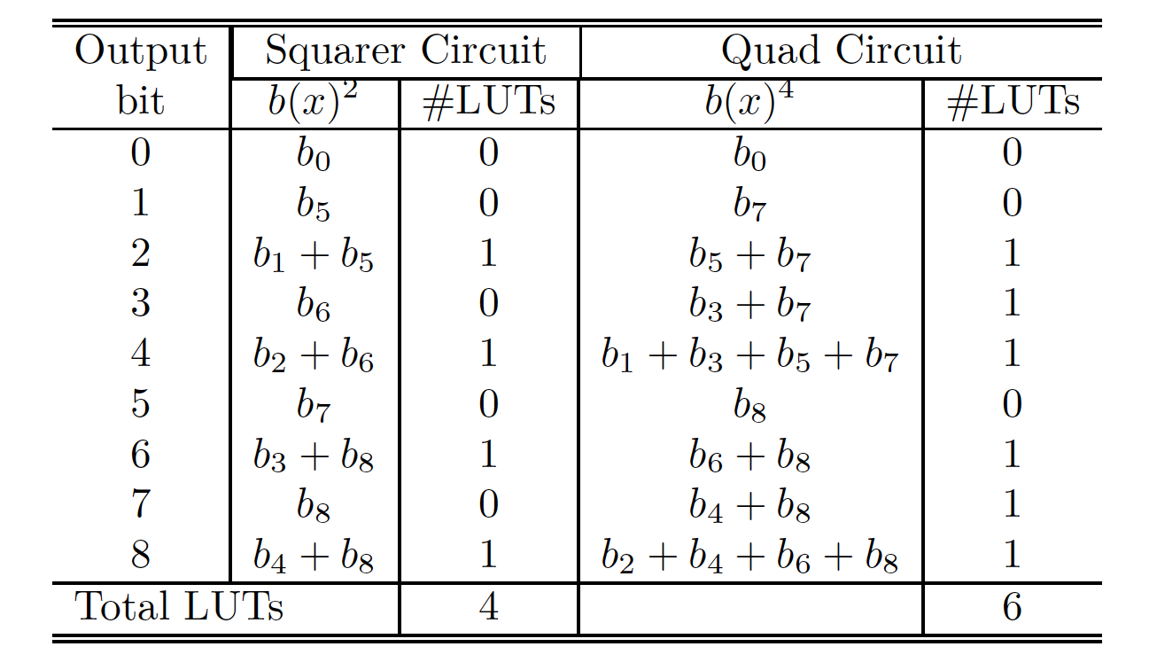
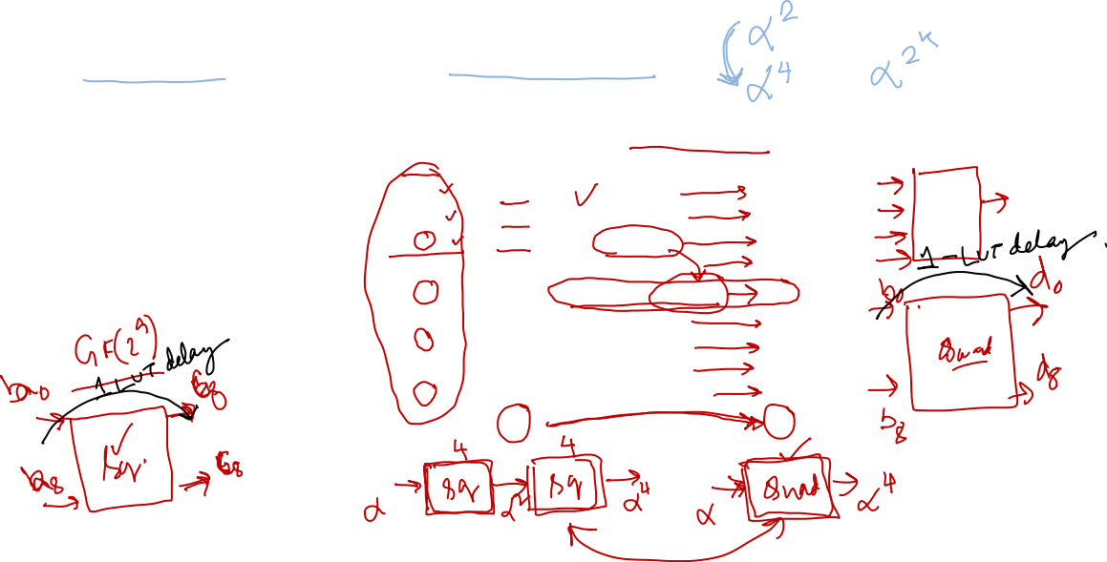
Quad Circuits vs Squarers
Comparison for LUTs required for Squarer and Quad for GF(2⁹)

Slide 17
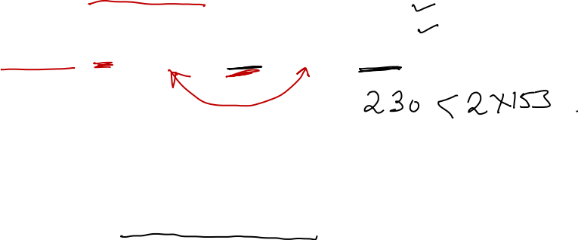
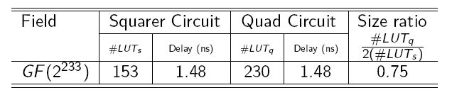
Using Quads Instead of Squarers
On an FPGA, Quads have better LUT utilization compared to squarers.
Delay of a quad and a squarer is the same
Therefore one can use a Quad Itoh-Tsujii algorithm which uses quad circuits instead of squarers.

Slide 18
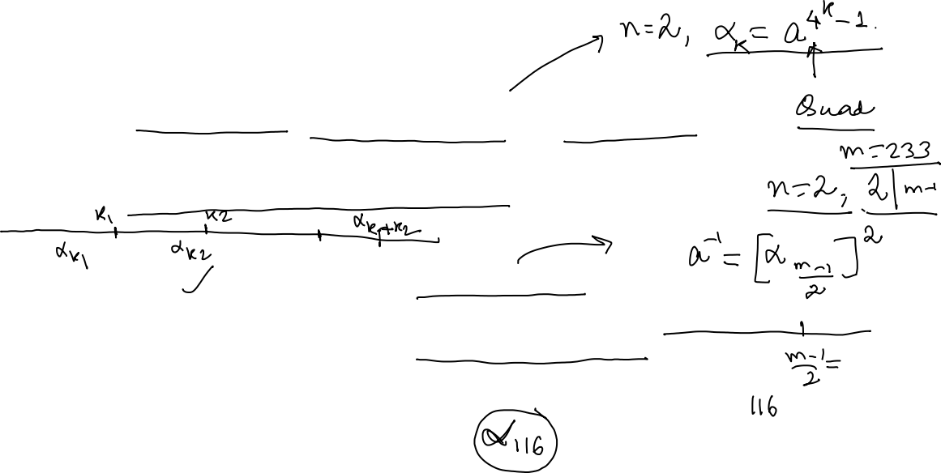
Generalisation of Itoh-Tsujii

Slide 19
Justification
Case 1: When n divides (m-1):
Case 2: When n does not divide (m-1):

Slide 20
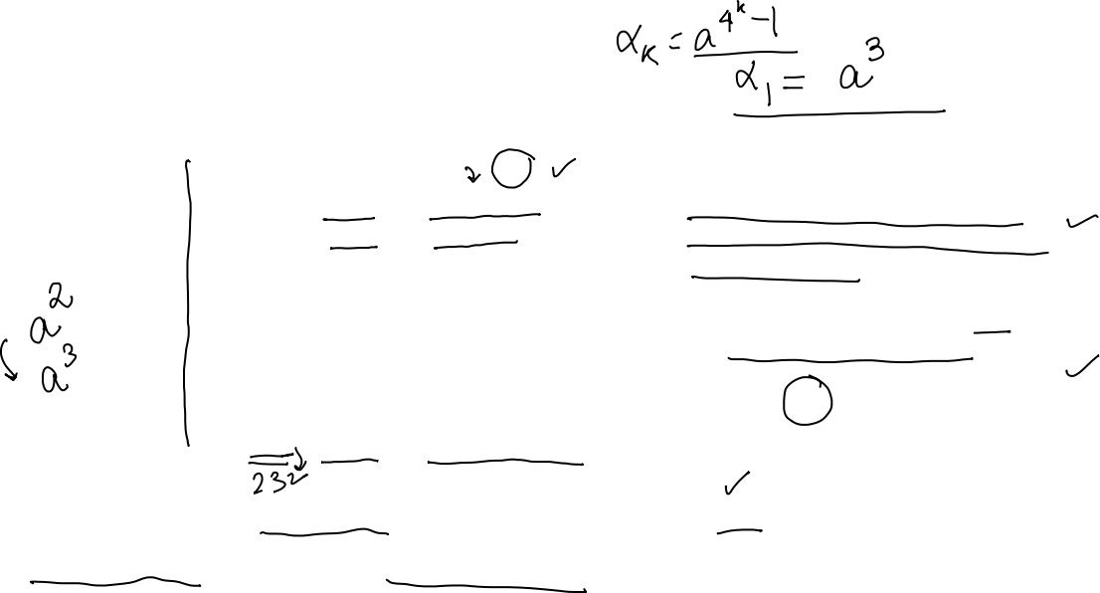
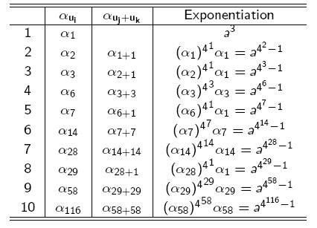
Quad Itoh Tsujii Algorithm
Initial Pre-computation:
To compute the cube, the multiplier is used for 2 clock cycles. Remember there is no squarer.
Likewise, the final squaring also is done by a multiplication step.
So, in total 12 multiplications.
We set n=2
We now require 115 quads (instead of 232) and 9 multiplications. We save 7 clock cycles.

Slide 21
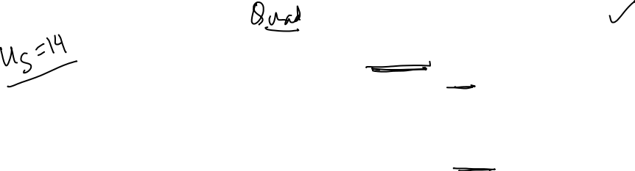
Estimating the number of clock cycles
#Multiplications: l-2+3=l+1. Note that 2 multiplications are needed initially for pre-computation, and one for final squaring.
Difference in clock cycle:
This can be as high as (m-1)/2 for GF(2^{m})

Slide 22


